Slide 1


Health Economics Lecture #4
Topic: The Rational Addiction Model
Prepared by Jacob Smith, Trent University

Slide 2
Learning Objectives
In this lecture we will discuss:
Some Empirical Puzzles on Income and Consumption of Addictive Goods
How Economists Think About Addiction
Rational Addiction Part I: Addictive Good Dynamics.
Rational Addiction Part II: Addiction Capital and Earnings
A “Two Panel” Rational Addiction Model
Goal of this Lecture:
Introduce the basics of the rational addiction model.
Show the differential effects addiction policy can have.

Slide 3
Some Empirical Puzzles on Income and Consumption of Addictive Goods

Slide 4
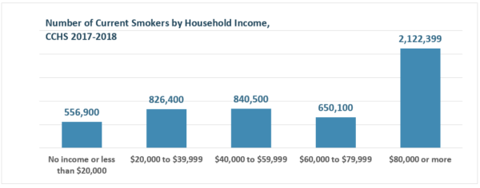
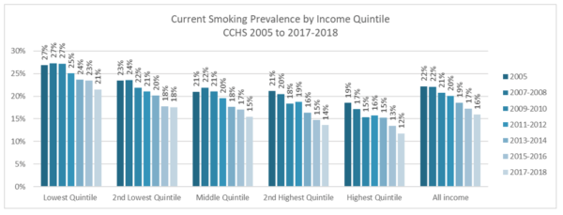
Some Conflicting Descriptive Statistics on Smoking and Incomes

Slide 5
Some Conflicting Descriptive Statistics on Smoking and Incomes
Wealthier Households Have More Smokers.
Prevalence of Smoking Among Lower Income.

Slide 6
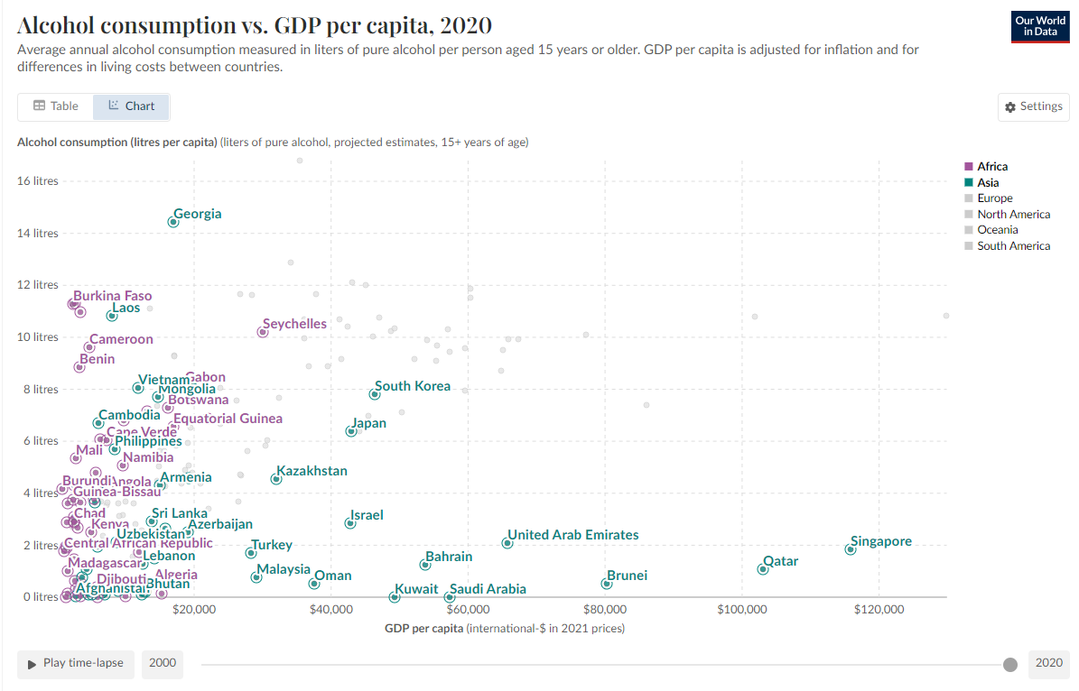
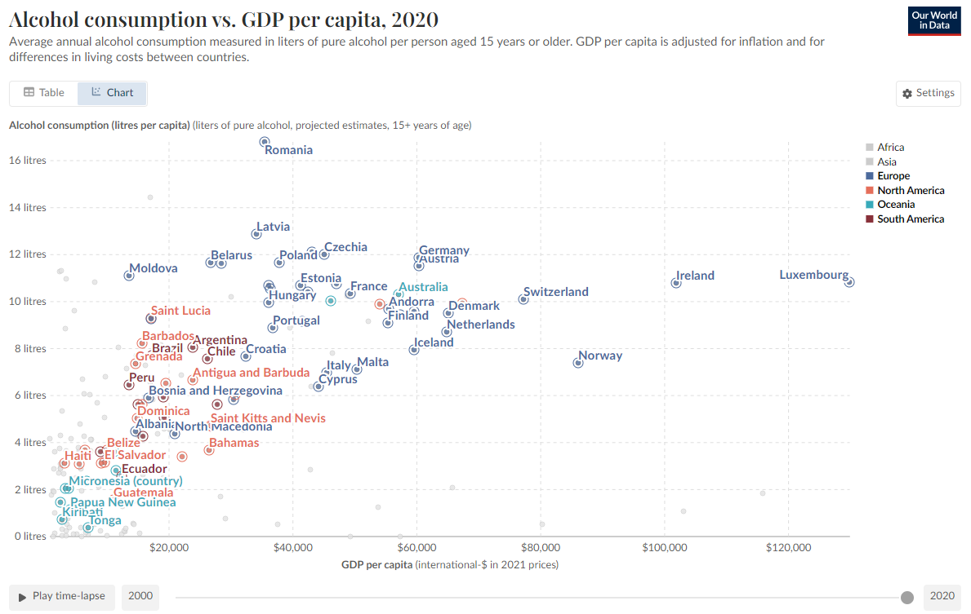
Conflicting Results on Alcohol Consumption and Earnings

Slide 7
Conflicting Results on Alcohol Consumption and Earnings
Higher GDP per Captia countries consume more alcohol (Europe, North America, Ocania and South America)
Higher GDP per capita countries consume less alcohol (Africa and Asia).

Slide 8
What these pictures are telling us
BOTH OF THESE ARE SHOWING OPPOSITE RESULTS ON THE RELATIONSHIP BETWEEN INCOME AND ADDICTIVE GOOD CONSUMPTION!
We see that in the case of smokers: 1) The Number of Current smokers are above median income. 2) Smoking is most prevalent among poorest.
In the case of alcohol consumption: 1) Higher GDP per capita in the west is associated with higher alcohol consumption and in turn higher wages. 2) Higher GDP per capita in the Africa and Asia is associated with lower alcohol consumption and in turn lower wages.
We will use the Rational Addiction Model to solve this puzzle and evaluate the regulation of addictive goods.

Slide 9
How Economists Think About Addiction

Slide 10
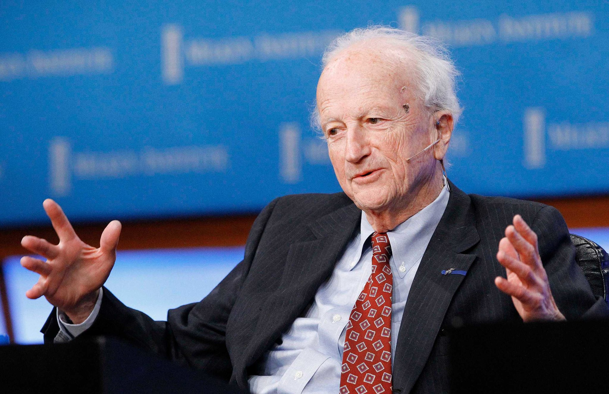

Who do we thank for the Rational Addiction Model?
Gary Becker, University of Chicago
Kevin Murphy, University of Chicago

Slide 11
What is the Rational Addiction Model?
The Rational Addiction Model was Published by Gary Becker and Kevin Murphy in 1988.
It was a model that sought to explain the consumption patterns of addictive goods as a result of a rational choice.
Two main contributions it made were:
The development of a economic model where the current demand of a good is dependent on previous consumption.
show how addictive good consumption can have Multiple Equilibria.
Practically, this mean two groups demand for addictive goods can respond differently to changes in price and income.

Slide 12
How Economists Think About Addiction
Recall, Economists think of individual outcomes as a result of individual decisions.
The analysis of addiction and the consumption of addictive goods are no different.
Addictive goods are goods who’s utility depends on past consumption. Formally this is called Addiction Capital.
Economists think of addiction as a form of learning, where consumption of an addictive good now can increase consumer utility from it later.

Slide 13






Visualizing Consumer Choice in the Rational Addiction Model
…
UTILITY IN PERIOD

Slide 14





Visualizing Consumer Choice in the Rational Addiction Model
…
UTILITY IN PERIOD
Consumers make decisions between non-addictive goods, addictive goods and saving

Slide 15


Visualizing Consumer Choice in the Rational Addiction Model
…
UTILITY IN PERIOD
These choices give a utility to consumers each period in addition to addiction capital.

Slide 16





Visualizing Consumer Choice in the Rational Addiction Model
These past choices impact not only future individual incomes, but also future individual preferences in the next period
…
UTILITY IN PERIOD

Slide 17
Visualizing Consumer Choice in the Rational Addiction Model
…
UTILITY IN PERIOD
The graphs presented will embody this underlying consumer behaviour

Slide 18
Addictive Good Dynamics
Rational Addiction Part I

Slide 19
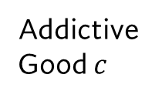


Addictive Good Consumption and Addiction Capital
The first chart in the rational addiction model is the relationship between addictive good consumption and addiction capital.
Addiction capital is conceptualized as weighted past consumption.
we assume the curve has the following shape.
Addictive Good $c$
$$c(s)$$
Addiction Capital $s$

Slide 20


Addictive Good Consumption and Addiction Capital
Past consumption does not impact the consumption of an addictive good unless addiction capital passes a certain threshold.
Behaviourally, you can think of alcohol consumption as requiring an “acquired taste” or previous experience to enjoy.
What threshold $s^{0}$ represents is the point where past consumption starts impacting the demand for addictive goods.
Addictive Good $c$
$$c(s)$$
$$s^{0}$$
Addiction Capital $s$

Slide 21
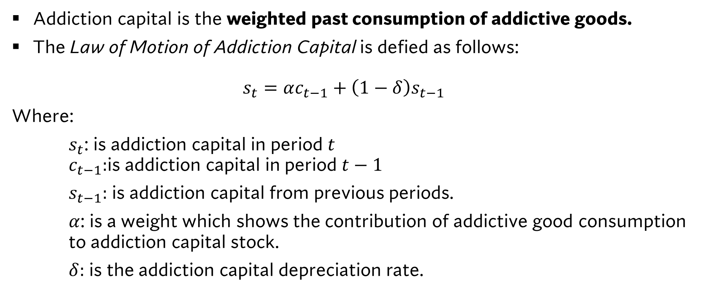
The law of motion of addiction capital
Addiction capital is the weighted past consumption of addictive goods.
The Law of Motion of Addiction Capital is defied as follows: $s_{t}=αc_{t−1}+\left(1−δ\right)s_{t−1}$
Where:
$s_{t}$: is addiction capital in period $t$ $c_{t−1}:$is addiction capital in period $t−1$
$s_{t−1}:$ is addiction capital from previous periods.
$α$: is a weight which shows the contribution of addictive good consumption to addiction capital stock.
$δ:$ is the addiction capital depreciation rate.

Slide 22
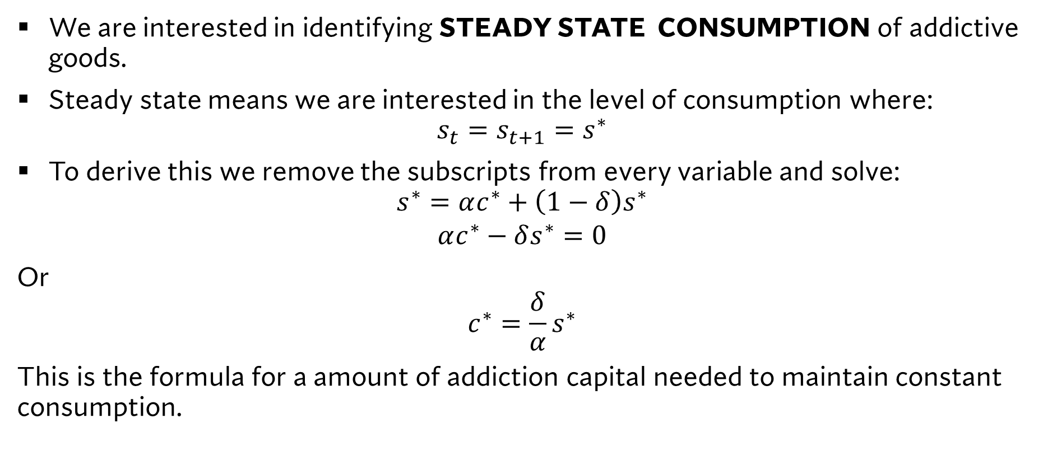
The law of motion of addiction capital
We are interested in identifying STEADY STATE CONSUMPTION of addictive goods.
Steady state means we are interested in the level of consumption where: $s_{t}=s_{t+1}=s^{∗}$
To derive this we remove the subscripts from every variable and solve: $s^{∗}=αc^{∗}+\left(1−δ\right)s^{∗}$
$$αc^{∗}−δs^{∗}=0$$
Or $$c^{∗}=\frac{δ}{α}s^{∗}$$
This is the formula for a amount of addiction capital needed to maintain constant consumption.

Slide 23


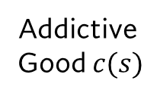
Addiction Capital
$$\frac{δ}{α}s^{∗}$$
Graphically we are going to want to plot this steady state line.
In the previously defined space.
Addictive Good $c(s)$
$$\frac{δ}{α}s$$
Addiction Capital $s$

Slide 24



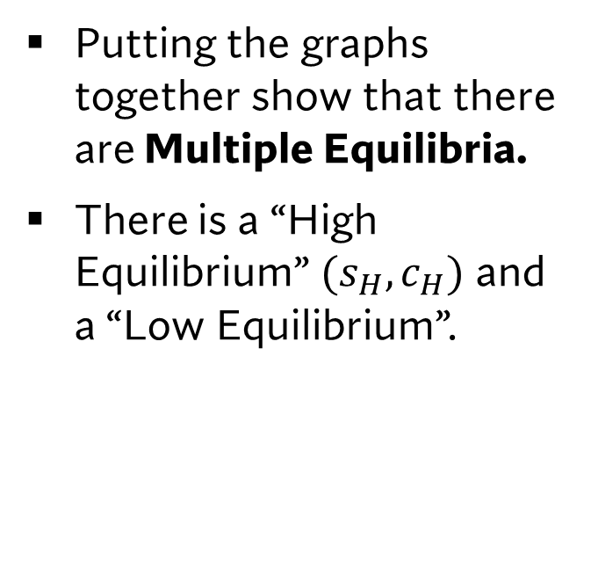



Equilibrium Addictive Good Consumption and Addiction Capital
Putting the graphs together show that there are Multiple Equilibria.
There is a “High Equilibrium” $(s_{H},c_{H})$ and a “Low Equilibrium”.
Addictive Good $c(s)$
$$\frac{δ}{α}s$$
$$c(s)$$
$$c_{H}$$
$$c_{L}$$
$$s_{L}$$
$$s_{H}$$
Addiction Capital $s$

Slide 25
Addiction Capital and Earnings
Rational Addiction Part II

Slide 26

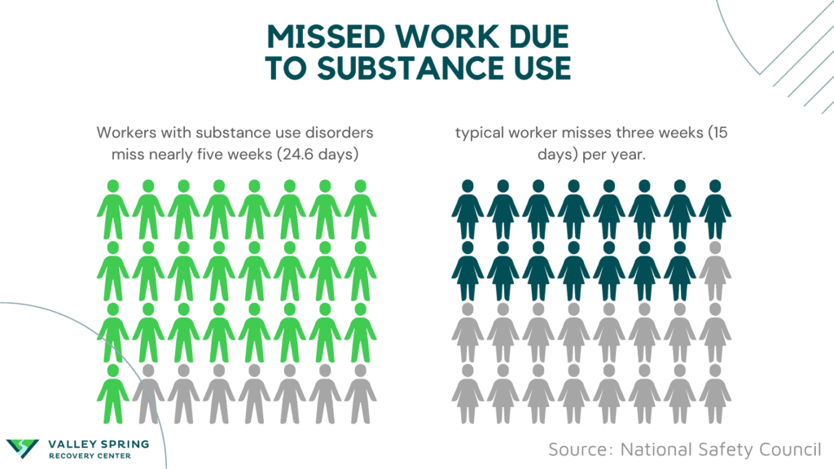
An assumption about drug use and productivity
An assumption that we make in this model is that there is an inverse relationship between earnings. (i.e. higher addiction capital implies lower wages). This is supported empirically:

Slide 27
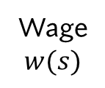

Addiction Capital and Wages
Wage $$w(s)$$
Graphically we are going to draw a separate chart which shows the relationship between wages/earnings and addiction capital.
Addiction Capital $s$

Slide 28


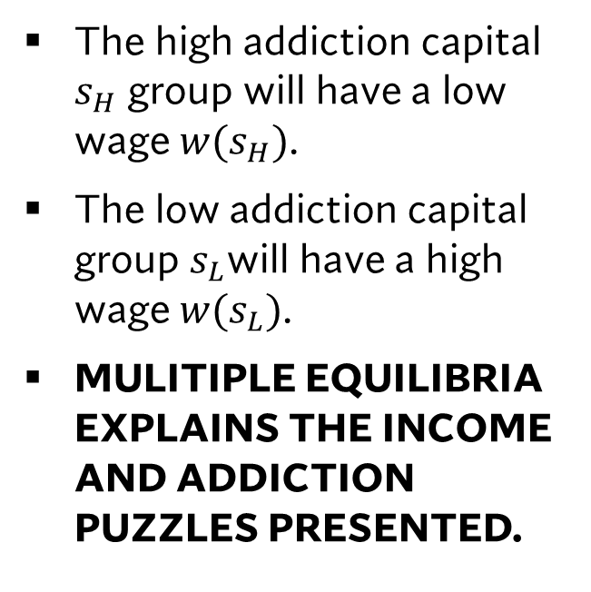


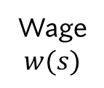
Addiction Capital and Wages
Wage $$w(s)$$
The high addiction capital $s_{H}$ group will have a low wage $w(s_{H})$.
The low addiction capital group $s_{L}$will have a high wage $w(s_{L})$.
MULITIPLE EQUILIBRIA EXPLAINS THE INCOME AND ADDICTION PUZZLES PRESENTED.
$$w(s_{L})$$
$$w(s_{H})$$
$$s_{L}$$
$$s_{H}$$
Addiction Capital $s$

Slide 29
A “Two Panel” Rational Addiction Model
Putting both pieces together.

Slide 30

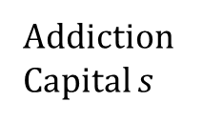







The “Two Panel” Rational Addiction Model
$$\frac{δ}{α}s$$
A simple way of orienting the two plots is in a single diagram as follows.
In this case, the wage curve is flipped upside down so equilibrium addictive good consumption can be connected to equilibrium wages.
YOU WILL USE THIS PICTURE IN YOUR PRESENTATION! (if appropriate)
$$c\left(s_{H}\right)$$
$$c\left(s\right)$$
Addictive Good $c$
$$c\left(s_{L}\right)$$
Addiction Capital $s$
$$w\left(s_{H}\right)$$
Wage $w$
$$w\left(s_{L}\right)$$

Slide 31



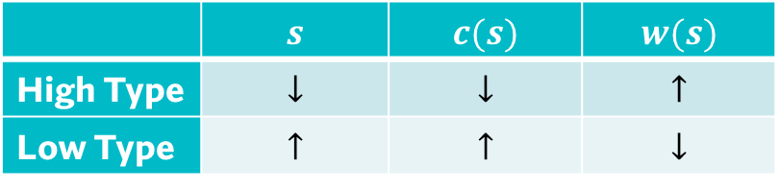



Scenario 1: An Increase in Price of Addictive Goods
$$\frac{δ}{α}s$$
When the price of addictive good $p_{c}$ increases the demand for addictive goods with respect to addiction capital shifts right.
$$c\left(s_{H}\right)$$
$$c\left(s\right)$$
$$c\left(s_{H}^{′}\right)$$
Addictive Good $c$
$$c\left(s_{L}^{′}\right)$$
$$c\left(s_{L}\right)$$
Addiction Capital $s$
 | $$s$$ | $$c(s)$$ | $$w(s)$$
High Type | $$↓$$ | $$↓$$ | $$↑$$
Low Type | $$↑$$ | $$↑$$ | $$↓$$
$$w\left(s_{H}\right)$$
$$w\left({s′}_{H}\right)$$
$$w\left({s′}_{L}\right)$$
Wage $w$
$$w\left(s_{L}\right)$$

Slide 32
Scenario 1: An Increase in Price of Addictive Goods
$$\frac{δ}{α}s$$
According to the model its possible that a price increase can cause consumers to “quit cold turkey”. (without quitting aides or support).
This means that there will never be any amount of addictive good consumption which will make it relevant for habit formation.
This is because addiction is unfeasible under any circumstances.
$$c\left(s_{H}\right)$$
$$c\left(s\right)$$
Addictive Good $c$
$$c\left(s_{L}\right)$$
Addiction Capital $s$
$$w\left(s_{H}\right)$$
Wage $w$
$$w\left(s_{L}\right)$$

Slide 33



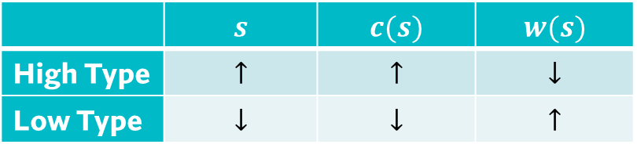

Scenario 2: An Increase in consumer non-labor Incomes.
$$\frac{δ}{α}s$$
$$c\left(s_{H}^{′}\right)$$
A rise in non wage income decreases the demand for addictive goods among the low type and increases it among the high type.
More income provides access to more of other goods for low type.
But more income reinforces addictive good consumption for the high type.
$$c\left(s_{H}\right)$$
$$c\left(s\right)$$
Addictive Good $c$
$$c\left(s_{L}\right)$$
 | $$s$$ | $$c(s)$$ | $$w(s)$$
High Type | $$↑$$ | $$↑$$ | $$↓$$
Low Type | $$↓$$ | $$↓$$ | $$↑$$
$$c\left(s_{L}^{′}\right)$$
Addiction Capital $s$
$$w\left({s′}_{H}\right)$$
$$w\left(s_{H}\right)$$
Wage $w$
$$w\left(s_{L}\right)$$
$$w\left({s′}_{L}\right)$$

Slide 34


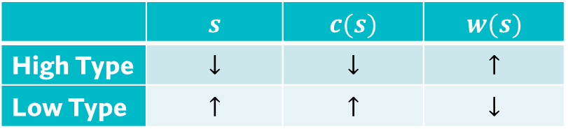




Scenario 3: Increased depreciation rate
$$\frac{δ′}{α}s$$
$$\frac{δ}{α}s$$
Depreciation in this context can be change due to change in access to quitting aides or other supports.
This makes the break even line steeper and rotating it to the left.
This is the same directional outcomes as a price incrase
$$c\left(s_{H}\right)$$
$$c\left(s\right)$$
$$c\left(s_{H}^{′}\right)$$
Addictive Good $c$
$$c\left(s_{L}^{′} \right)$$
$$c\left(s_{L}\right)$$
Addiction Capital $s$
 | $$s$$ | $$c(s)$$ | $$w(s)$$
High Type | $$↓$$ | $$↓$$ | $$↑$$
Low Type | $$↑$$ | $$↑$$ | $$↓$$
$$w\left(s_{H}\right)$$
$$w\left(s_{H}^{′}\right)$$
$$w\left(s_{L}^{′}\right)$$
Wage $w$
$$w\left(s_{L}\right)$$

Slide 35
Practice Questions
$$\frac{δ}{α}s$$
How does the introduction of “supervised injection sites” impact the rational addiction model?
How do negative income shocks (say from a recession in the economy) impact the demand for addictive goods for high and low groups?
TRICKY QUESTION: What happens the demand for addictive goods when the price of Non Addictive Goods Change.
$$c\left(s_{H}\right)$$
$$c\left(s\right)$$
Addictive Good $c$
$$c\left(s_{L}\right)$$
Addiction Capital $s$
$$w\left(s_{H}\right)$$
Wage $w$
$$w\left(s_{L}\right)$$

Slide 36
Practice Questions
$$\frac{δ}{α}s$$
How does the introduction of “supervised injection sites” impact the rational addiction model?
How do negative income shocks (say from a recession in the economy) impact the demand for addictive goods for high and low groups?
TRICKY QUESTION: What happens the demand for addictive goods when the price of Non Addictive Goods Change.
$$c\left(s_{H}\right)$$
$$c\left(s\right)$$
Addictive Good $c$
$$c\left(s_{L}\right)$$
Addiction Capital $s$
$$w\left(s_{H}\right)$$
Wage $w$
$$w\left(s_{L}\right)$$

Slide 37
Concluding Remarks
The Rational Addiction model is useful for evaluating the differential response addiction policy can have.
Policies that help the high addiction group can harm the low addiction group and vice versa.
In general, the low equilibria is considered unstable, meaning it is a group that either moves to zero addiction capital or to the high addiction category.
This is why addiction policy (from a purely economic perspective) is targeted at high addicted groups.

Slide 38
Learning Objectives
In this lecture we will discuss:
Some Empirical Puzzles on Income and Consumption of Addictive Goods
How Economists Think About Addiction
Rational Addiction Part I: Addictive Good Dynamics.
Rational Addiction Part II: Addiction Capital and Earnings
A “Two Panel” Rational Addiction Model
Goal of this Lecture:
Introduce the basics of the rational addiction model.
Show the differential effects addiction policy can have.

